Slide 1
Dictionary-Based Techniques
Prof. Sebastián Vallejo Vera

Slide 2
In our previous session, we counted words. That was fairly straightforward but gave us a sense on how to approach a text.
In this session, rather than counting words, we will be counting specific words.

Slide 3
Dictionaries
(Not really dictionaries... More like thesauruses)

Slide 4
We start, as always, with an assumption: the occurrence of a specific token (or a series of tokens, or a combination of tokens) provides a substantive and interpretable characteristic of the text.
Let’s look at two approaches that use the occurrence of specific tokens: keywords and dictionaries.
Note: I sort of made-up the name of keywords as an approach. Ultimately, you can think of a keyword as a dictionary with only one representation of that concept.

Slide 5
Keywords
From the previous session, word-frequency analysis requires:
Determining the unit of analysis
Tokenization
Counting words over space and/or time
Denominating by totals

Slide 6
Keyword analysis requires:
Determining the unit of analysis
Tokenization
Counting a specific word over space and/or time
Denominating by totals

Slide 7
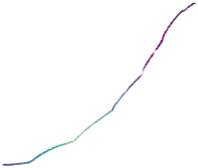
Examples:
Imagine a corpus of weekly class evaluations. Each document is an individual evaluation. We can count words over time:
Count all words for each time unit t (e.g., week)
Count all words denoting a word of interest (e.g., “amazing”)
Amazing Frequency
Week

Slide 8
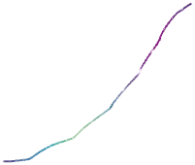
Total tokens
Prop. Of Amazing
Week
Week

Slide 9


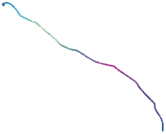
Total tokens
Prop. Of Amazing
Week
Week

Slide 10
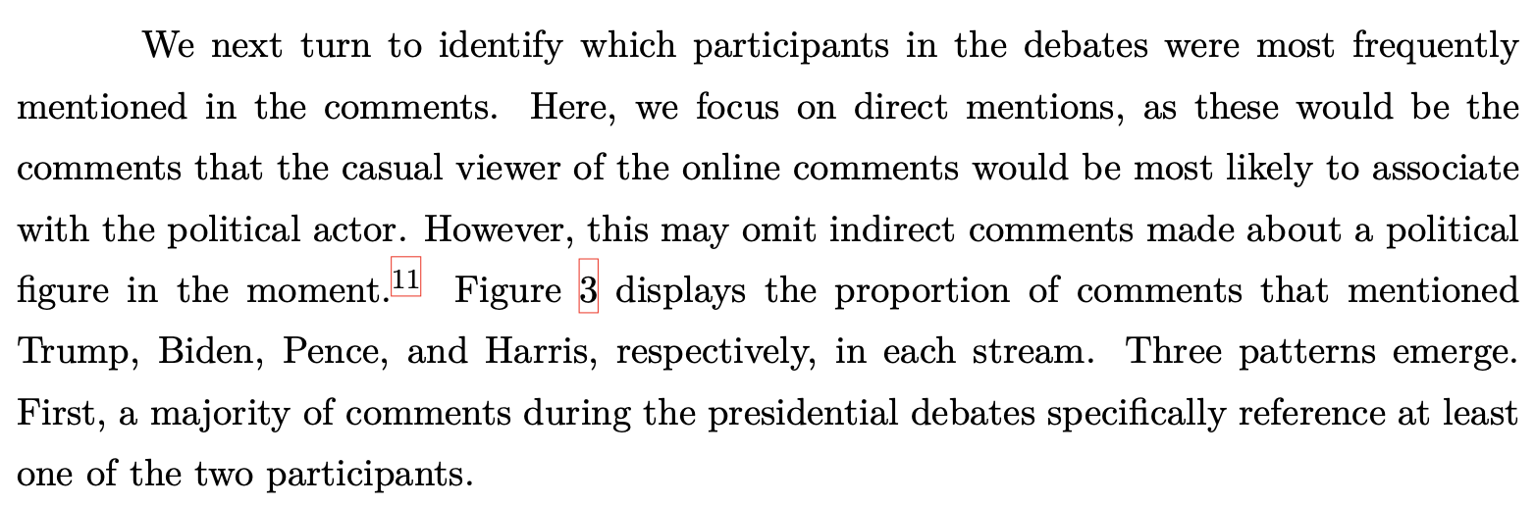
It is usually not as straightforward. Take, for example, the analysis by Ventura et al. (2021) - Connective effervescence and streaming chat during political debates:

Slide 11
Here are two comments from their data:
Fox News: “President Trump doing a great job!!! Biden no clue!!!!!”
ABC News: “Joe Biden act more like a president than Trump did tonight”
They tokenize every text and estimate the proportion of comments that contain either ”Trump” or “Biden”.
Note that estimating the proportion of comments if denominating by the total (in this case, the total being documents).

Slide 12
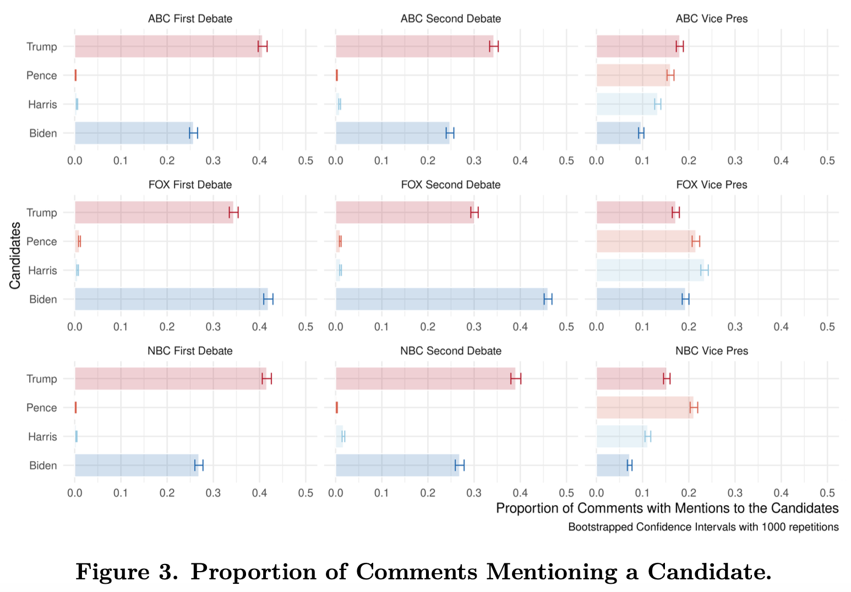

Slide 13
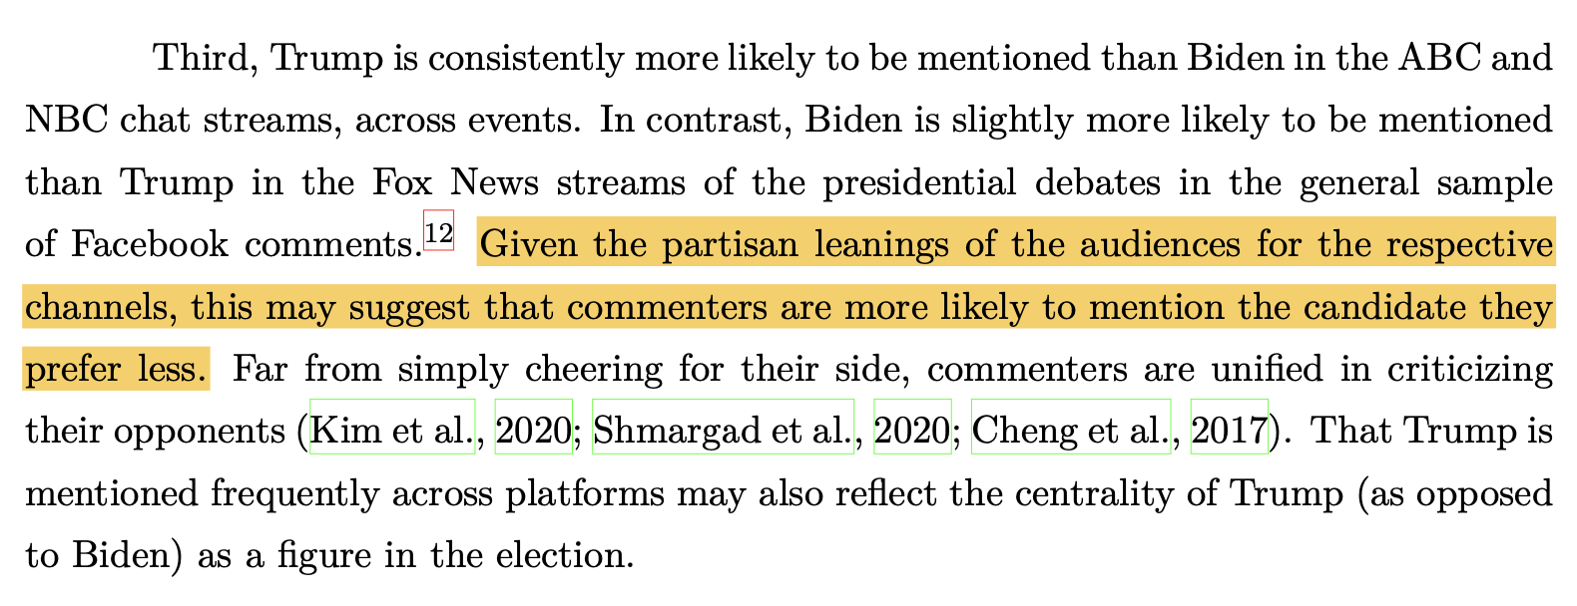

Slide 14
That is a likely explanation.
However, why aren’t the authors more conclusive about their findings?

Slide 15
Are false positives / false negatives randomly distributed?
Is mentioning a candidate a sign of preference? For? Against?
Are there alternative ways that the same concept can occur in the text?
Take these examples:
ABC News: “Trump has more to say because he can actually follow the topics and joe is just sleepy and stupid Gtf out of here joe”
Fox News: “Yes Mr. President you absolutely have ‘....done more in 47 months than Biden has done in 47 years’!”

Slide 16
There are some additional tools that can give validation to your analysis.
Keywords-in-context (kwic): What other words are occurring around our word of interest?
Collocation analysis: identify contiguous collocations of words (what two+ words are occurring together?)
N-grams: Search for tokens that often occur together—e.g., donald-trump, joe-biden, white-house.

Slide 17
Dictionaries
A concept can be expressed using different words. We can use sentiment as an example. To conduct sentiment analysis, we need:
Determining the unit of analysis
Tokenization
Counting a words with a dictionary over space and/or time
Denominating by totals

Slide 18
We first define the concept (see Grimmer et al. Ch. 15 for best practices).
Let’s take a sentiment: positive language. What words should occur in the text to denote it as a positive text?
Good
Amazing
Happy
Better
Best
Incredible
Achieve (from WordStat Sentiment Dictionary)
Esthetical (from SentiWordNet)

Slide 19
Examples:
Imagine a corpus of weekly class evaluations. Each document is an individual evaluation. We can count words over time:
Count all words for each time unit t (e.g., week)
Count all words denoting a concept of interest (e.g., the ones from our newly created dictionary)
Positive Frequency
Week

Slide 20
Total tokens
Prop. Of Amazing
Week
Week

Slide 21
Total tokens
Prop. Of Amazing
Week
Week

Slide 22
What if we also had words indicating other types of sentiment.
For example: “I was furious to be at a lecture at 9AM but I was filled with utter joy and elation upon entering the classroom…”
Is this positive or negative?
How would you go about denominating our measure of sentiment?

Slide 23
What if we also had words indicating other types of sentiment.
For example: “I was furious to be at a lecture at 9AM but I was filled with utter joy and elation upon entering the classroom…”
+ 2 positive words
+ 1 negative word
23 total words
Positive: 2/23 = 0.087
Negative: 1/23 = 0.044
What else could we do?

Slide 24
We can also create ratio variables (e.g., a ratio of positive sentiment):
2 (positive) – 1 (negative) = +1. Interpretation?
2 (positive) / 1 (negative) = 2. Interpretation?
2 (positive) / 1 (negative) = 2. Interpretation?
Martins and Baumard (2020): (2 – 1) / (2 + 1) = 1/3. Interpretation?
Young and Soroka (2012) : (2/23) – (1/23) = 0.044. Interpretation?
TF-IDF: (2/23) * log(1/1) = Not relevant. Interpretation?

Slide 25
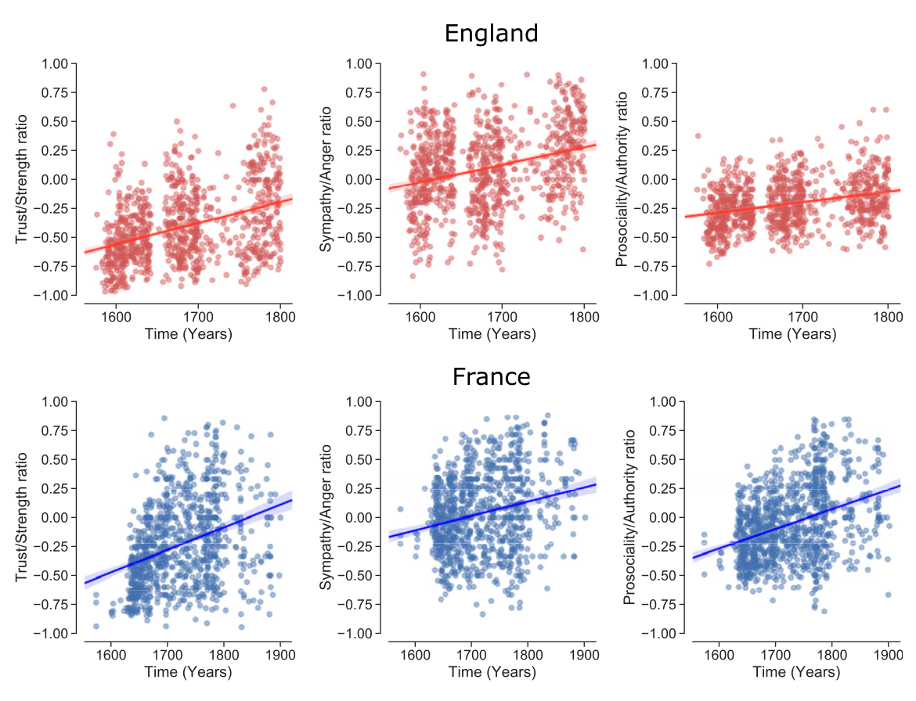

How might this change if we estimate the ratios differently?
How would the interpretation change?

Slide 26
Some final considerations
Do we care about the degree (valence) with which a word denotes a concept?
Do we care the utter joy > joy > glad ?
Does it matter that opposing concepts (e.g., positive v. negative) might have unbalanced synonyms?
Does it matter that some words can change the meaning of words?
For example: not happy != happy.

